Slide 1

Graphing Algorithms
Definition and Application

Slide 2
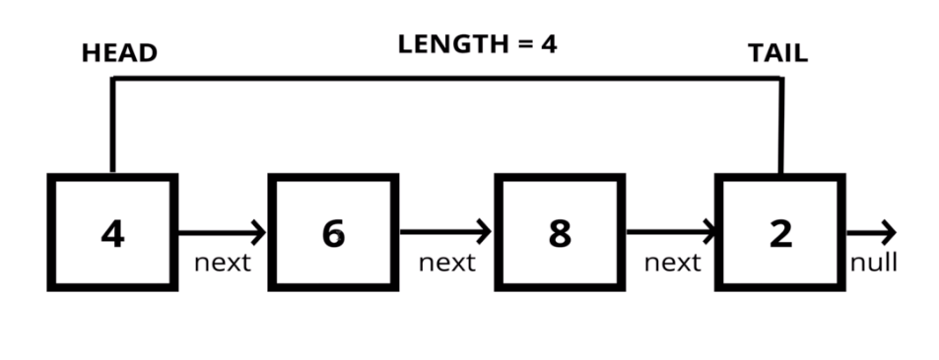
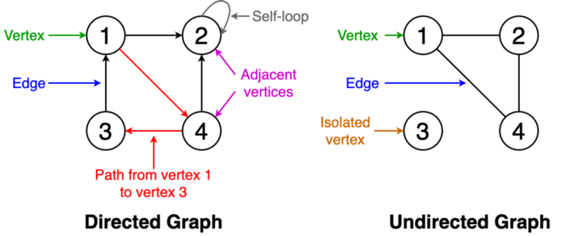
Definition
Vertexes
Might also be called “nodes”
Edges
Might also be called “links”
Given some vertexes and edges…
… how do we get from Point A to Point B?

Slide 3
Searching
Breadth First (Queue based)
Depth First (Stack based)

Slide 4
Cycle Detection
Shortest Path

Slide 5
Questions?
Comments?
Snide remarks?

